Slide 1
UNIT- VI

Slide 2
UNIT – VI ANALYTICAL LEARNING
Learning with perfect domain theory (Book-2)
– Explanation based Learning
– Inductive analytical approach to learning
– KBANN algorithm

Slide 3
EXPLANATION BASED LEARNING
Inductive learning methods such as Neural Network and Decision Tree Learning, Inductive Logic Programming, and Genetic Algorithms require a certain number of training examples to achieve a given level of generalization accuracy (Specific to General).
Analytical learning uses Prior Knowledge and Deductive Reasoning to augment the information provided by the training examples, so that it is not subject to these same bounds (General to specific).
EX: Explanation-Based Learning (EBL) when the learner's prior knowledge is correct and complete.
EBL is a analytical approach which uses prior knowledge
Prior knowledge is used to analyze, or explain, how each observed training example satisfies the target concept.
Explanation is used to distinguish the relevant features vs irrelevant, and so examples can be generalized based on logical rather than statistical reasoning.

Slide 4
EBL algorithms accept explicit prior knowledge as an input, in addition to the input training data.
This generalizes more accurately than inductive systems that rely on the data alone.
It uses prior knowledge to reduce the complexity of the hypothesis space to be searched.
Consider the task of learning to play chess. (Figure 11.1 )
Chess program to learn to recognize important classes of game positions, such as the target concept "chessboard positions in which black will lose its queen within two moves" .
The chessboard is fairly complex (32 pieces and 64 squares), and because the particular patterns that capture this concept are fairly subtle.
Provide thousands of training examples like Fig.11.1 to expect an inductively learned hypothesis to generalize correctly to new situations.

Slide 5
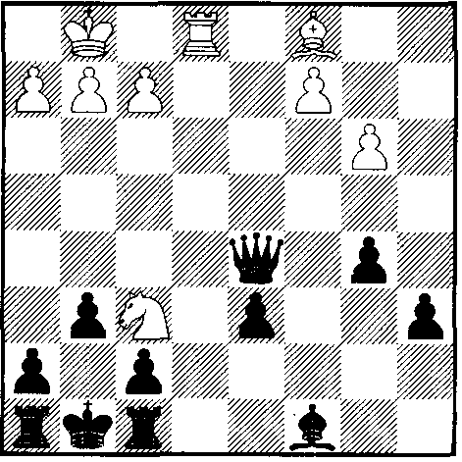
The answer appears to be that people rely heavily on explaining, or analyzing, the training example in terms of their prior knowledge about the legal moves of chess.
FIGURE 11.1 : A positive example of the target concept "chess positions in which black will lose its queen within two moves." Note the white knight is simultaneously attacking both the black king and queen. Black must therefore move its king, enabling white to capture its queen.

Slide 6
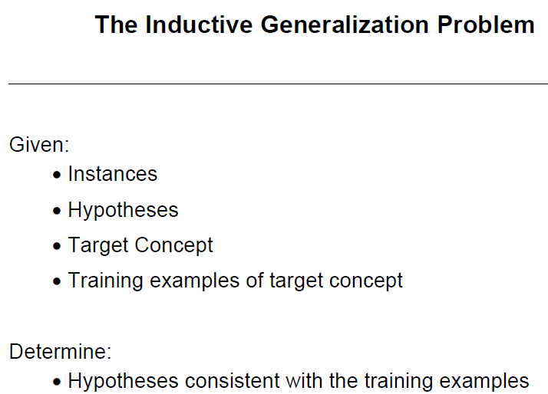
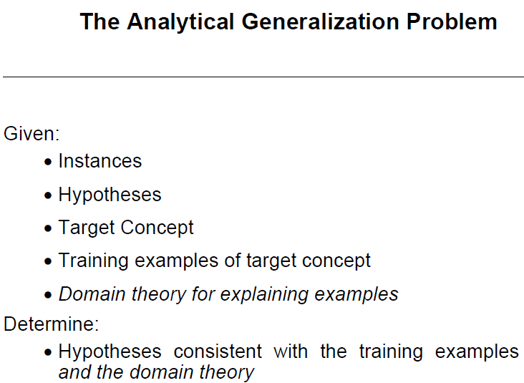

Slide 7

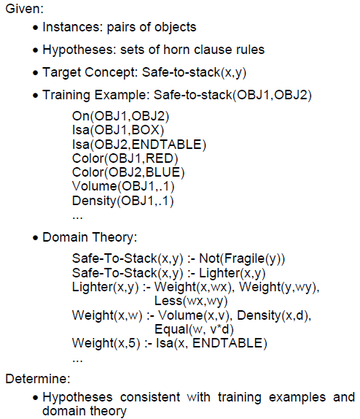

Slide 8
LEARNING WITH PERFECT DOMAIN THEORIES:
PROLOG-EBG
PROLOG is logic programming language
PROLOG is a declarative language
Logic is expressed in the form of relations (facts and rules)
Consider EBL from domain theories that are perfect, that is, domain theories that are correct and complete.
A domain theory is said to be correct if each of its assertions is a truthful statement about the world.
A domain theory is said to be complete with respect to a given target concept and instance space, if the domain theory covers every positive example in the instance space.
If we follow the usual PROLOG convention that un-provable assertions are assumed to be false, then this definition of completeness includes full coverage of both positive and negative examples by the domain theory.
First, there are cases in which it is feasible to provide a perfect domain theory.
Second, in many other cases it is unreasonable to assume that a perfect domain theory is available.

Slide 9
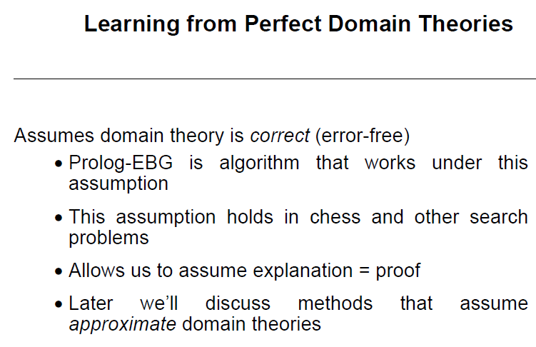

Slide 10
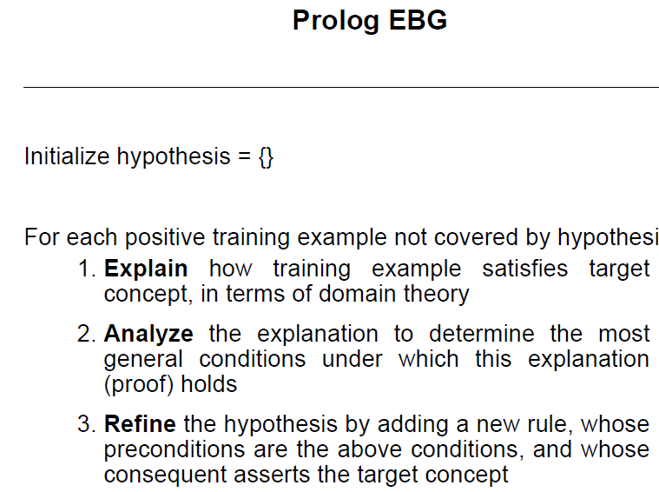

Slide 11
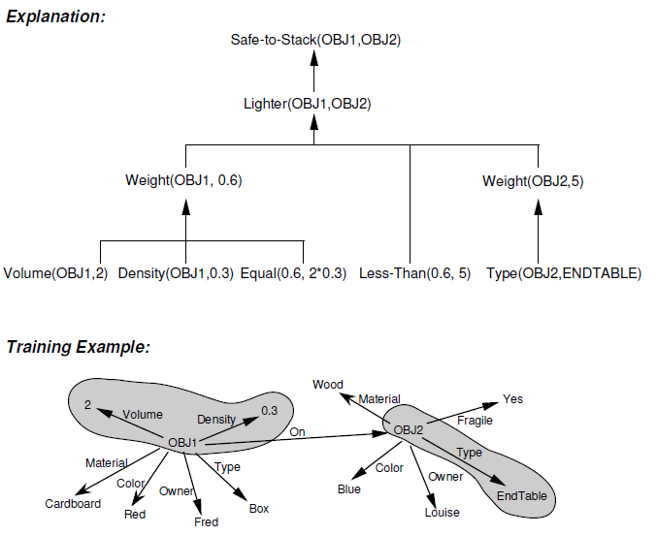

Slide 12
REMARKS ON EXPLANATION-BASED LEARNING
The following are the key properties of this algorithm.
It produces justified general hypotheses by using prior knowledge to analyze individual examples.
The explanation of how the example satisfies the target concept determines which example attributes are relevant.
Analysis of the explanation allows deriving more general constraints on the values of the relevant features.
Each learned Horn clause corresponds to a sufficient condition for satisfying the target concept.
The generality depends on the formulation of the domain theory and on the sequence.
It assumes that the domain theory is correct and complete.

Slide 13

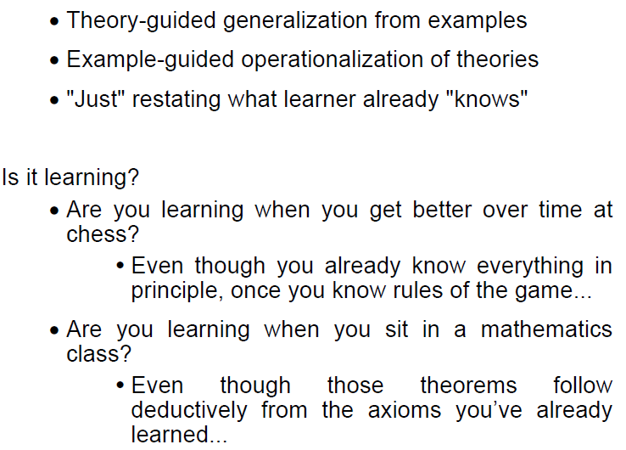

Slide 14
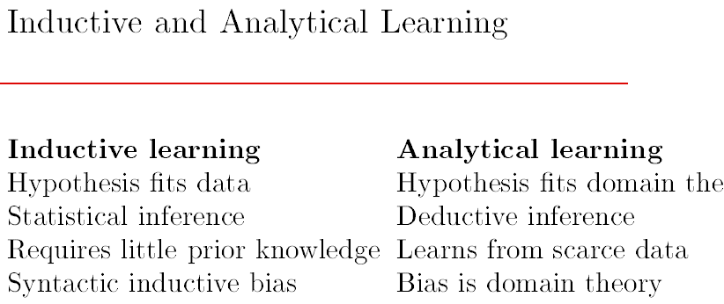

Inductive

Slide 15
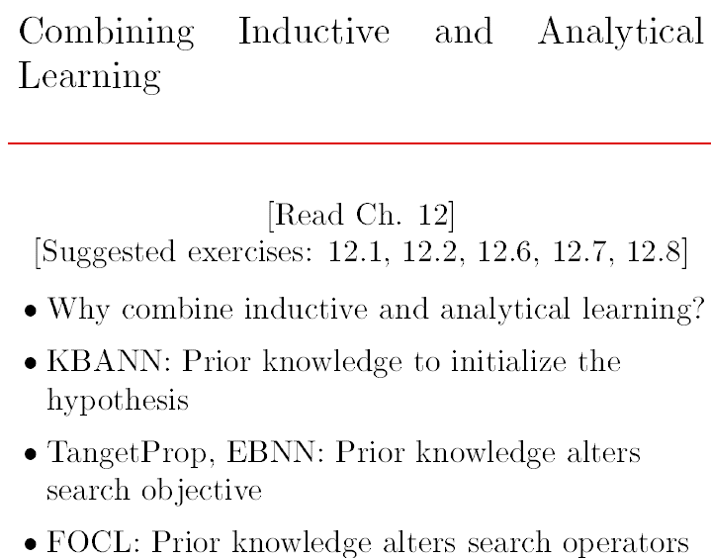

Slide 16

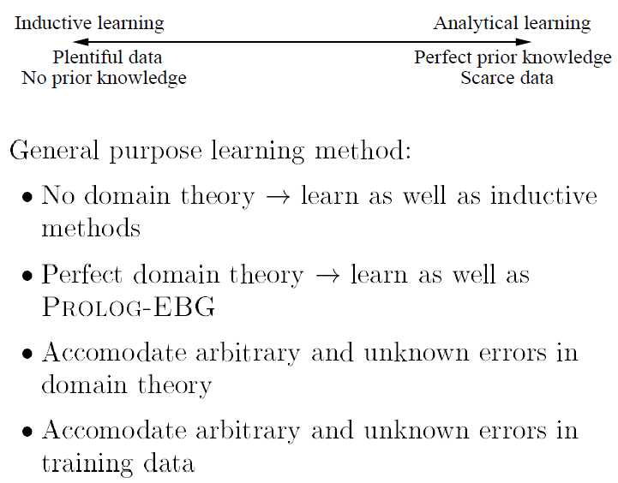

Slide 17
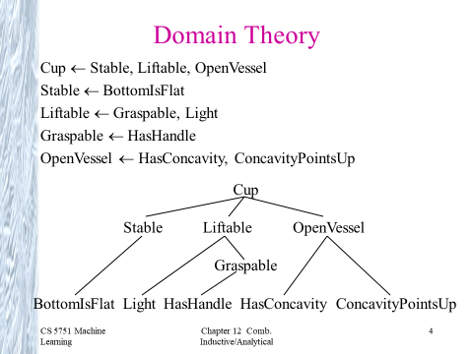

Slide 18
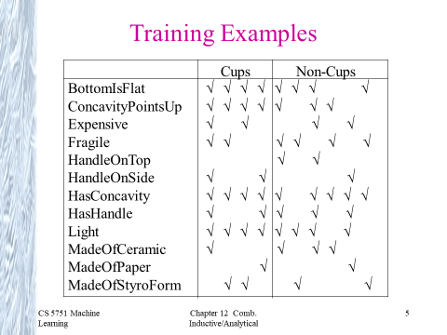

Slide 19
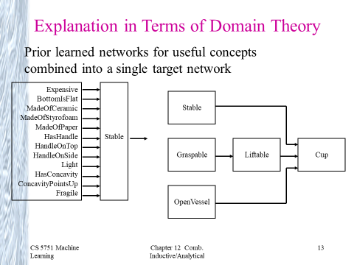

Slide 20
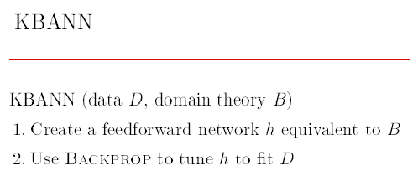
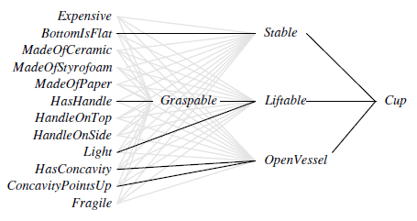
Knowledge-Based Artificial Neural Networks
KBANN is an hybrid learning system (combine both domain knowledge + Training examples)

Slide 21
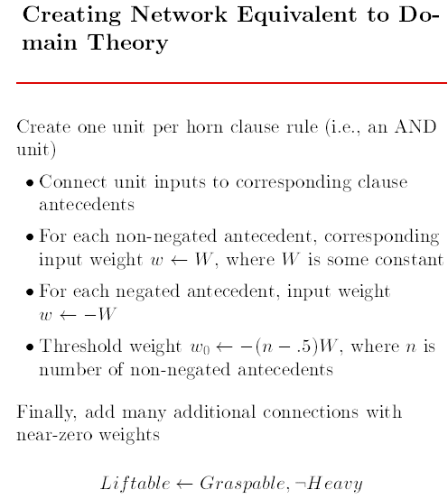

Slide 22
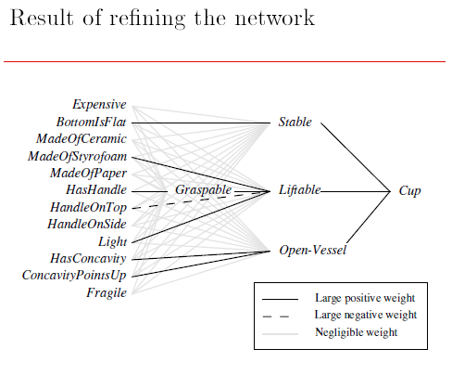

Slide 23
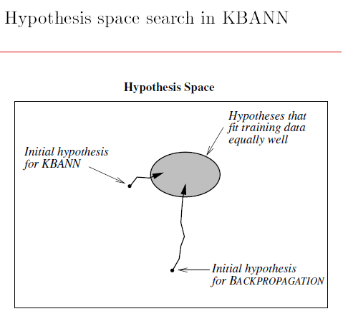

Slide 24
THANK YOU

